Slide 1
Ocean thermal energy conversion (OTEC) systems

Slide 2
What is OTEC
OTEC systems use the ocean's natural thermal gradient—the fact that the ocean's layers of water have different temperatures—to drive a power-producing cycle.
In deep tropical waters ocean surface temperature can be as high as 27 ℃; and at depths as close as 1000 ft below the surface, temperature can be as low as 4 ℃.

Slide 3
OTEC system
There are three types of electricity conversion systems: closed-cycle, open-cycle, and hybrid.
Closed-cycle systems use the ocean's warm surface water to vaporize a working fluid, which has a low-boiling point, such as ammonia.

Slide 4
Introduction
Renewable Ocean Energy:
Tides, Currents, and Waves.
Oceans cover more than 70% of Earth's surface, making them the world's largest solar collectors.

Slide 5
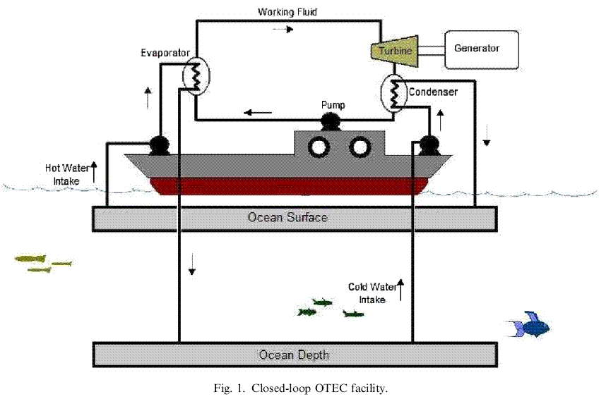
Closed-loop OTEC facility

Slide 6
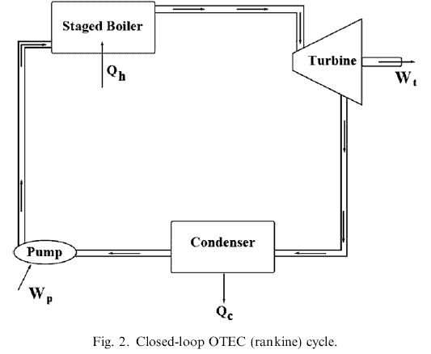
Closed-loop OTEC cycle

Slide 7
An OTEC system application case
Hydrogen can be produced via electrolysis using electricity generated by the OTEC process.
Stored hydrogen can then be transported and used to power fuel cells.

Slide 8
Scale of Hydropower Projects
Large-hydro
  More than 100 MW feeding into a large electricity grid
Medium-hydro
  15 - 100 MW usually feeding a grid
Small-hydro
  1 - 15 MW - usually feeding into a grid
Mini-hydro
  Above 100 kW, but below 1 MW
  Either stand alone schemes or more often feeding into the grid
Micro-hydro
  From 5kW up to 100 kW
  Usually provided power for a small community or rural industry in remote areas away from the grid.
Pico-hydro
  From a few hundred watts up to 5kW
  Remote areas away from the grid.
www.itdg.org/docs/technical_information_service/micro_hydro_power.pdf

Slide 9
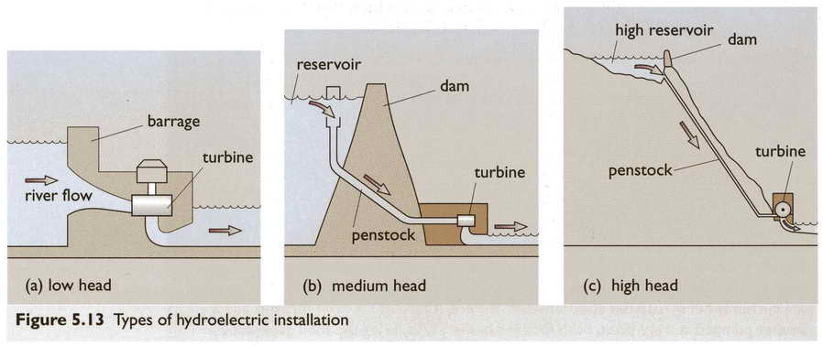
Types of Hydroelectric Installation
Boyle, Renewable Energy, 2nd edition, Oxford University Press, 2003

Slide 10
Dry Steam Power Plants
“Dry” steam extracted from natural reservoir
  180-225 ºC ( 356-437 ºF)
  4-8 MPa (580-1160 psi)
  200+ km/hr (100+ mph)
Steam is used to drive a turbo-generator
Steam is condensed and pumped back into the ground
Can achieve 1 kWh per 6.5 kg of steam
  A 55 MW plant requires 100 kg/s of steam
Boyle, Renewable Energy, 2nd edition, 2004

Slide 11
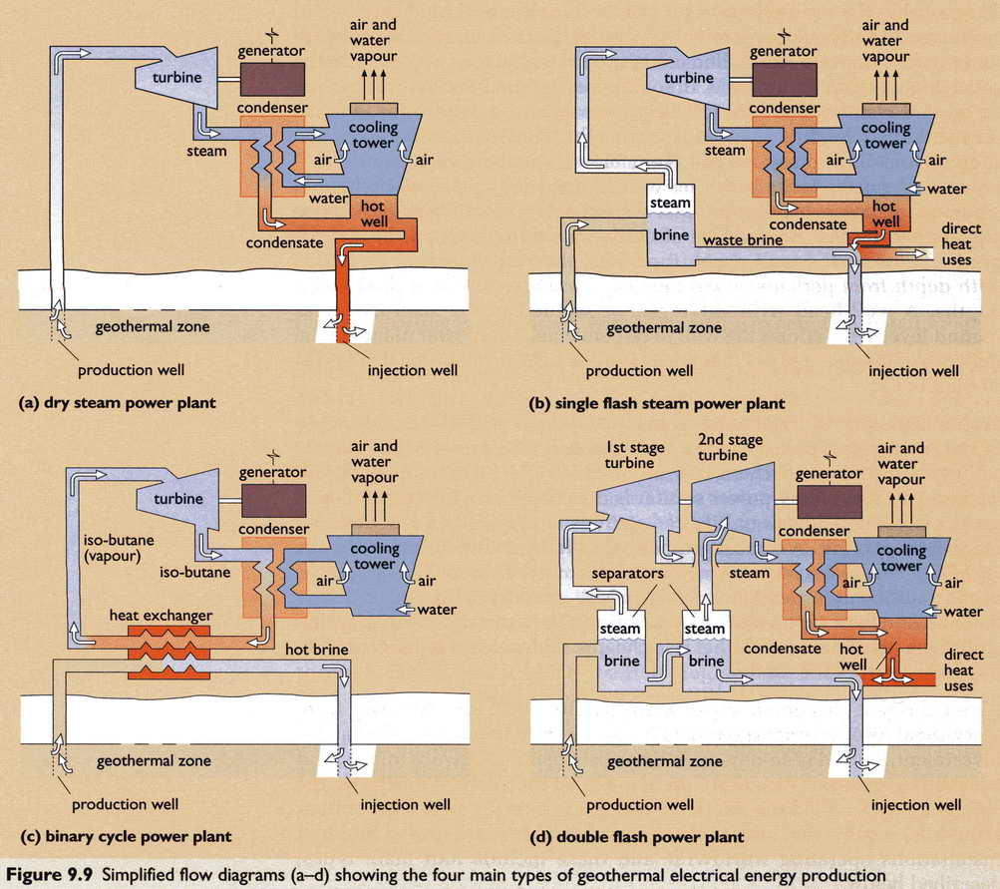
Dry Steam Schematic
Boyle, Renewable Energy, 2nd edition, 2004

Slide 12
Single Flash Steam Power Plants
Steam with water extracted from ground
Pressure of mixture drops at surface and more water “flashes” to steam
Steam separated from water
Steam drives a turbine
Turbine drives an electric generator
Generate between 5 and 100 MW
Use 6 to 9 tonnes of steam per hour
Notes:
The steam once it has been separated from the water is piped to the powerhouse where it is used to drive the steam turbine. The steam is condensed after leaving the turbine, creating a partial vacuum and thereby maximising the power generated by the turbine-generator. The steam is usually condensed either in a direct contact condenser, or a heat exchanger type condenser. In a direct contact condenser the cooling water from the cooling tower is sprayed onto and mixes with the steam. The condensed steam then forms part of the cooling water circuit, and a substantial portion is subsequently evaporated and is dispersed into the atmosphere through the cooling tower. Excess cooling water called blow down is often disposed of in shallow injection wells. As an alternative to direct contact condensers shell and tube type condensers are sometimes used, as is shown in the schematic below. In this type of plant, the condensed steam does not come into contact with the cooling water, and is disposed of in injection wells.
Typically, flash condensing geothermal power plants vary in size from 5 MWe to over 100 MWe. Depending on the steam characteristics, gas content, pressures, and power plant design, between 6 and 9 tonne of steam each hour is required to produce each MW of electrical power. Small power plants (less than 10 MW) are often called well head units as they only require the steam of one well and are located adjacent to the well on the drilling pad in order to reduce pipeline costs. Often such well head units do not have a condenser, and are called backpressure units. They are very cheap and simple to install, but are inefficient (typically 10-20 tonne per hour of steam for every MW of electricity) and can have higher environmental impacts.

Slide 13
Single Flash Steam Schematic
Boyle, Renewable Energy, 2nd edition, 2004
Notes:
Flash Steam Power Plant
This is the most common type of geothermal power plant. The illustration below shows the principal elements of this type of plant. The steam once it has been separated from the water is piped to the powerhouse where it is used to drive the steam turbine. The steam is condensed after leaving the turbine, creating a partial vacuum and thereby maximising the power generated by the turbine-generator. The steam is usually condensed either in a direct contact condenser, or a heat exchanger type condenser. In a direct contact condenser the cooling water from the cooling tower is sprayed onto and mixes with the steam. The condensed steam then forms part of the cooling water circuit, and a substantial portion is subsequently evaporated and is dispersed into the atmosphere through the cooling tower. Excess cooling water called blow down is often disposed of in shallow injection wells. As an alternative to direct contact condensers shell and tube type condensers are sometimes used, as is shown in the schematic below. In this type of plant, the condensed steam does not come into contact with the cooling water, and is disposed of in injection wells.
Typically, flash condensing geothermal power plants vary in size from 5 MWe to over 100 MWe. Depending on the steam characteristics, gas content, pressures, and power plant design, between 6 and 9 tonne of steam each hour is required to produce each MW of electrical power. Small power plants (less than 10 MW) are often called well head units as they only require the steam of one well and are located adjacent to the well on the drilling pad in order to reduce pipeline costs. Often such well head units do not have a condenser, and are called backpressure units. They are very cheap and simple to install, but are inefficient (typically 10-20 tonne per hour of steam for every MW of electricity) and can have higher environmental impacts.
http://www.worldbank.org/html/fpd/energy/geothermal/technology.htm

Slide 14
Binary Cycle Power Plants
Low temps – 100º and 150ºC
Use heat to vaporize organic liquid
  E.g., iso-butane, iso-pentane
Use vapor to drive turbine
  Causes vapor to condense
  Recycle continuously
Typically 7 to 12 % efficient
0.1 – 40 MW units common
http://www.worldenergy.org/wec-geis/publications/reports/ser/geo/geo.asp
Notes:
Binary Cycle Power Plants
In reservoirs where temperatures are typically less than 220oC (430oF). but greater than 100oC (212oF). binary cycle plants are often utilised.
The illustration below shows the principal elements of this type of plant. The reservoir fluid (either steam or water or both) is passed through a heat exchanger which heats a secondary working fluid which has a boiling point lower than 100oC (212oF). This is typically an organic fluid such as Isopentane, which is vaporised and is used to drive the turbine. The organic fluid is then condensed in a similar manner to the steam in the flash power plant described above, except that a shell and tube type condenser rather than direct contact is used. The fluid in a binary plant is recycled back to the heat exchanger and forms a closed loop. The cooled reservoir fluid is again re-injected back into the reservoir. Binary cycle type plants are usually between 7 and 12 % efficient depending on the temperature of the primary (geothermal) fluid. http://www.worldbank.org/html/fpd/energy/geothermal/technology.htm
If the geothermal resource has a temperature between 100o and 150oC, electricity can still be generated using binary plant technology. The produced fluid heats, through a heat exchanger, a secondary working fluid (isobutane, isopentane or ammonia), which vaporises at a lower temperature than water. The working fluid vapour turns the turbine and is condensed before being reheated by the geothermal water, allowing it to be vaporised and used again in a closed-loop circuit (Figure 12.3). The size of binary units range from 0.1 to 40 MWe. Commercially, however, small sizes (up to 3 MWe) prevail, often used modularly, reaching a total of several tens of MWe installed in a single location. The spent geothermal fluid of all types of power plants is generally injected back into the edge of the reservoir for disposal and to help maintain pressure. In the case of direct heat utilisation, the geothermal water produced from wells (which generally do not exceed 2 000 metres) is fed to a heat exchanger before being reinjected into the ground by wells, or discharged at the surface. Water heated in the heat exchanger is then circulated within insulated pipes that reach the end-users. The network can be quite sizeable in district heating systems. For other uses (greenhouses, fish farming, product drying, industrial applications) the producing wells are next to the plants serviced. http://www.worldenergy.org/wec-geis/publications/reports/ser/geo/geo.asp

Slide 15
Binary Cycle Schematic
Boyle, Renewable Energy, 2nd edition, 2004
Notes:
Binary Cycle Power Plants
In reservoirs where temperatures are typically less than 220oC (430oF). but greater than 100oC (212oF). binary cycle plants are often utilised.
The illustration below shows the principal elements of this type of plant. The reservoir fluid (either steam or water or both) is passed through a heat exchanger which heats a secondary working fluid which has a boiling point lower than 100oC (212oF). This is typically an organic fluid such as Isopentane, which is vaporised and is used to drive the turbine. The organic fluid is then condensed in a similar manner to the steam in the flash power plant described above, except that a shell and tube type condenser rather than direct contact is used. The fluid in a binary plant is recycled back to the heat exchanger and forms a closed loop. The cooled reservoir fluid is again re-injected back into the reservoir. Binary cycle type plants are usually between 7 and 12 % efficient depending on the temperature of the primary (geothermal) fluid. http://www.worldbank.org/html/fpd/energy/geothermal/technology.htm
If the geothermal resource has a temperature between 100o and 150oC, electricity can still be generated using binary plant technology. The produced fluid heats, through a heat exchanger, a secondary working fluid (isobutane, isopentane or ammonia), which vaporises at a lower temperature than water. The working fluid vapour turns the turbine and is condensed before being reheated by the geothermal water, allowing it to be vaporised and used again in a closed-loop circuit (Figure 12.3). The size of binary units range from 0.1 to 40 MWe. Commercially, however, small sizes (up to 3 MWe) prevail, often used modularly, reaching a total of several tens of MWe installed in a single location. The spent geothermal fluid of all types of power plants is generally injected back into the edge of the reservoir for disposal and to help maintain pressure. In the case of direct heat utilisation, the geothermal water produced from wells (which generally do not exceed 2 000 metres) is fed to a heat exchanger before being reinjected into the ground by wells, or discharged at the surface. Water heated in the heat exchanger is then circulated within insulated pipes that reach the end-users. The network can be quite sizeable in district heating systems. For other uses (greenhouses, fish farming, product drying, industrial applications) the producing wells are next to the plants serviced. http://www.worldenergy.org/wec-geis/publications/reports/ser/geo/geo.asp

